Slide 1
Data Structures and Algorithms (CCE 221)
By
Dr : Asmaa Aly Hagar

Slide 2
Course Academic Calendar
Week Num | Date | Content
Week1 | 24/9/2025 | Introduction to Data Structures + Mathematics Review + Review of Concepts of ‘C++’
Week2 | 01/10/2025 | Sparse Matrix, Concepts of Class, and Analysis of Algorithms
Week3 | 08/10/2025 | Linked Lists
Week4 | 15/10/2025 | Stack
Week5 | 22/10/2025 | Queue
Week6 | 29/10/2025 | Trees
Week7 | 05/11/2025 | Midterm
Week8 | 12/11/2025 | AVL Trees
Week9 | 19/11/2025 | Priority Queues and Heaps
Week10 | 26/11/2025 | Graph
Week11 | 03/12/2025 | Searching and Sorting
Week12 | 10/12/2025 | Hashing

Slide 3
Lecture5

Slide 4
Contents of the Lecture
What is a Queue?
Operations on Queue
Queue ADT
Applications of Queue
Implementation of Queue
Types of Queue
Queue STL and deque STL

Slide 5

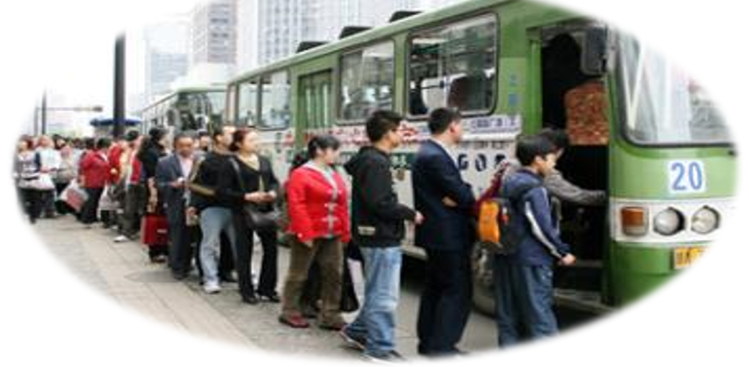
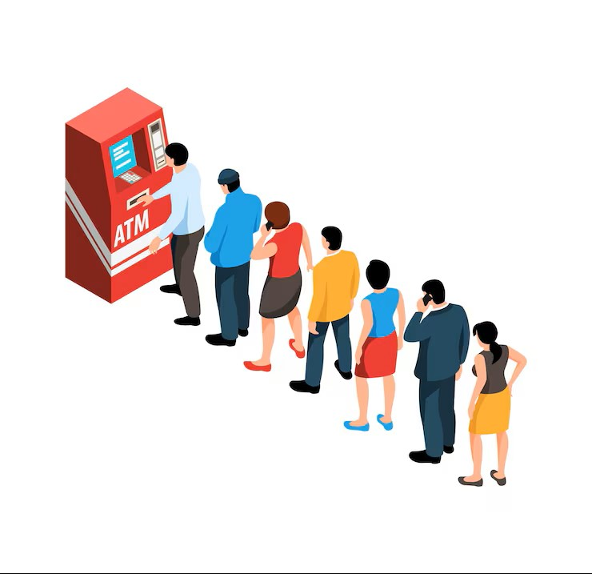
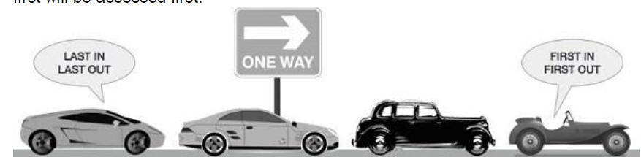
What is a Queue?

Slide 6
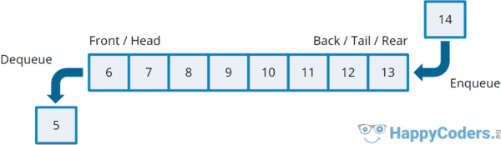
What is a Queue?
Queue is a linear data structure which follows the principle of FIFO ( FIFO or first come first serve).
It is called First in First out (FIFO) or Last in Last out (LILO) list.
It is a homogeneous collection of elements in which new elements are added at one end called rear or tail , and the existing elements are deleted from other end called front or head.
20
20
5
20
5
30
5
30
30
30
0
30
0
-3
Add (20)
Add (5)
Add (30)
Delete
Delete
Add (0)
Add (-3)

Slide 7
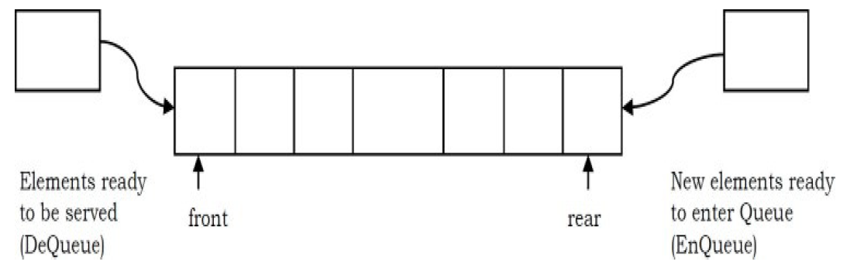
Operations on Queue
Similar to Stacks, special names are given to the two changes that can be made to a queue. When an element is inserted in a queue, the concept is called EnQueue, and when an element is removed from the queue, the concept is called DeQueue.
DeQueueing an empty queue is called underflow and EnQueuing an element in a full queue is called overflow. Generally, we treat them as exceptions.

Slide 8
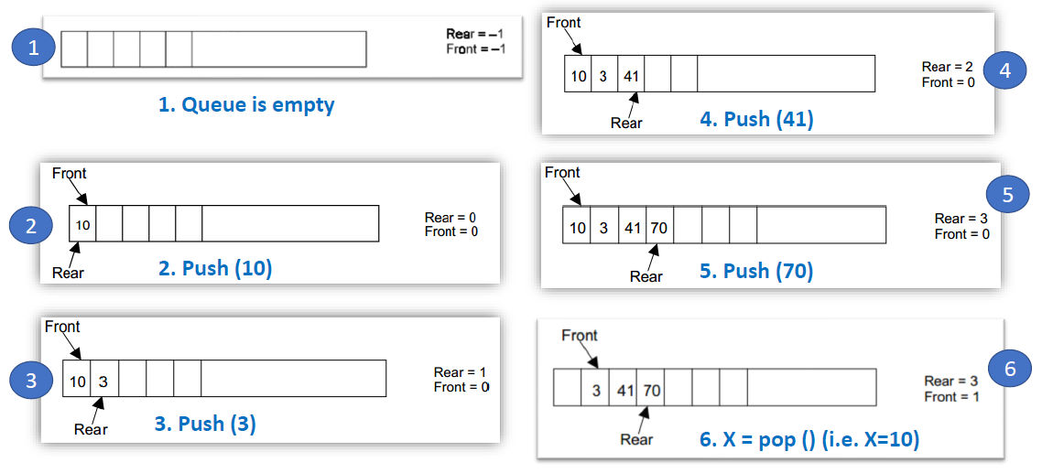
Operations on Queue

Slide 9
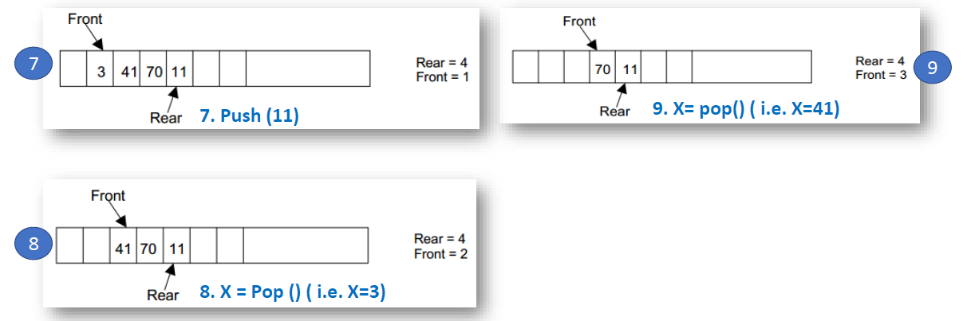
Operations on Queue

Slide 10
Queue ADT
The following operations make a queue an ADT. Insertions and deletions in the queue must follow the FIFO scheme. For simplicity we assume the elements are integers.
Main Queue Operations
EnQueue(int data): Inserts an element at the end of the queue
int DeQueue(): Removes and returns the element at the front of the queue
Auxiliary Queue Operations
int Front(): Returns the element at the front without removing it
int QueueSize(): Returns the number of elements stored in the queue
int IsEmptyQueueQ: Indicates whether no elements are stored in the queue or not
Similar to other ADTs, executing DeQueue on an empty queue throws an “Empty Queue Exception” and executing EnQueue on a full queue throws “Full Queue Exception”.

Slide 11
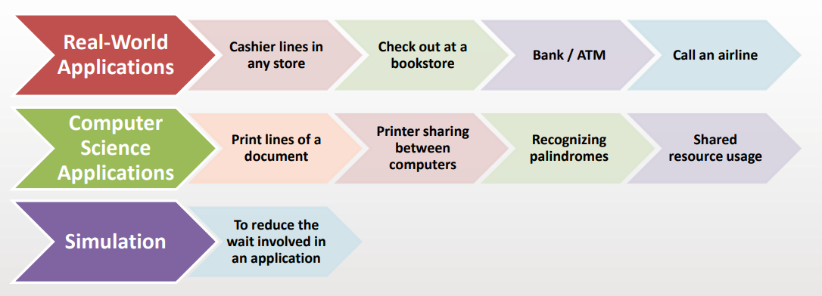
Applications of Queue
Notes:
In simulation, a queue models real-world waiting lines — like people waiting for service, data packets waiting to be processed, or jobs waiting for CPU time.
Queues help us simulate systems where entities arrive, wait, get served, and depart.

Slide 12
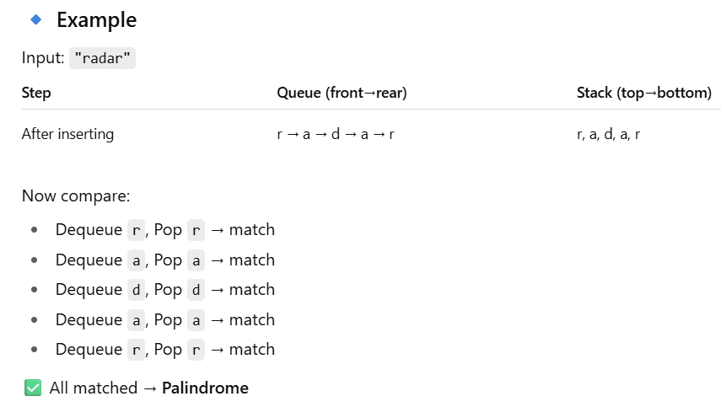
Applications of Queue
A palindrome is a sequence that remains unchanged when reversed.
Examples:
Words: madam, level, racecar

Slide 13
Implementation of Queue
Queue data structure can be implemented in two ways.
Using arrays (static)
Using pointers (linked lists) (dynamic)
Using two stacks (static and dynamic depending on the stack implementation)
When a queue is implemented using an array, that queue can organize an only limited number of elements.
When a queue is implemented using a linked list, that queue can organize an unlimited number of elements.

Slide 14
Array Implementation of Queue
The implementation of queue data structure using array is very simple.
Just define a one-dimensional array of specific size and insert or delete the values into that array by using FIFO (First In First Out) principle with the help of variables 'front' and 'rear’.
Initially both 'front' and 'rear' are set to -1.
Whenever, we want to insert a new value into the queue, increment 'rear' value by one and then insert at that position.
Whenever we want to delete a value from the queue, then delete the element which is at 'front' position and increment 'front' value by one.
Total number of elements present in the queue is |front-rear-1| or rear-front+1 , when implemented using arrays.

Slide 15
Array Implementation of Queue
Underflow and overflow conditions can occur when a queue is implemented using arrays .
Question: Do you think that overflow and underflow occurs in dynamic?
If we try to dequeue (or delete or remove) an element from queue when it is empty underflow occurs .
It is not possible to delete (or take out) any element when there is no element in the queue.
If we try to enqueue (or add or insert) an element from queue when it is full overflow occurs .
When queue is full it is naturally not possible to insert any more elements

Slide 16
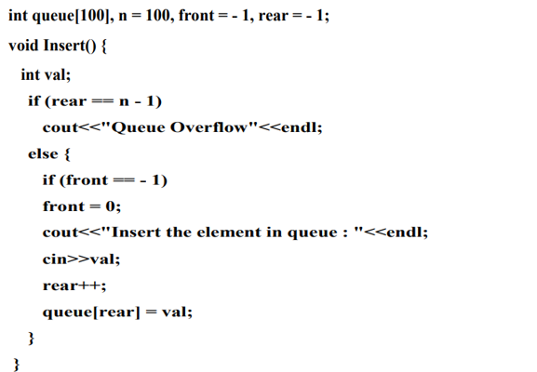
Array Implementation of Queue

Slide 17
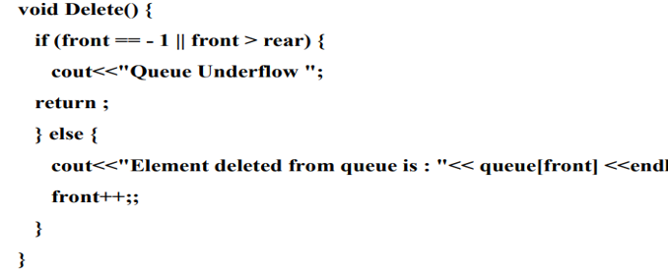
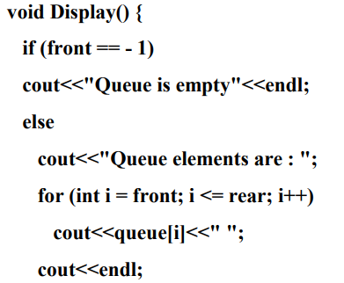
Array Implementation of Queue

Slide 18
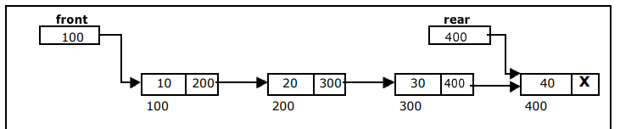
Linked List Implementation of Queue
We can represent a queue as a linked list.
In a queue data is deleted from the front end and inserted at the rear end.
We use two pointers front and rear for the linked queue implementation.

Slide 19
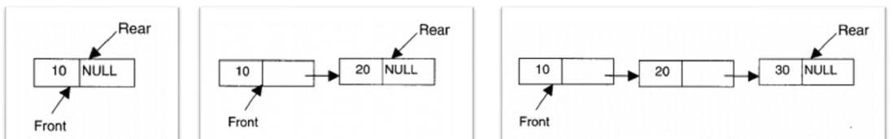
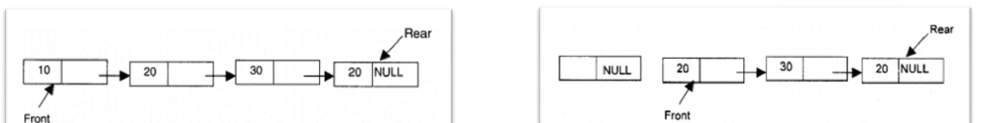
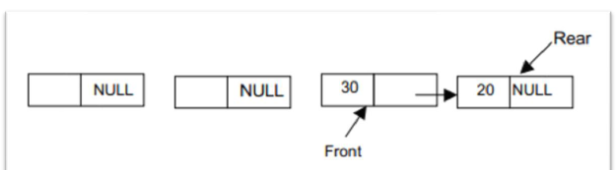
Linked List Implementation of Queue
Enqueue(10)
Enqueue(20)
Enqueue(30)
Enqueue(20)
Dequeue()
Dequeue()

Slide 20
Linked List Implementation of Queue
Algorithm for Enqueue Operation
REAR is a pointer in queue where the new elements are added.
FRONT is a pointer pointing to the queue where the elements are deleted .
DATA is a data element to be added.

Slide 21
Linked List Implementation of Queue
Algorithm for Dequeue Operation
REAR is a pointer in queue where the new elements are added.
FRONT is a pointer, which is pointing to the queue where the elements are popped.
DATA is a data element deleted from the queue.

Slide 22
Stacks Implementation of Queue
A queue can be implemented using two stacks.
Suppose STACK1 and STACK2 are the two stacks.
When an element is added (enqueue) on to the queue , push the same on STACK1
When an element is deleted (dequeue) from the queue , pop all elements of STACK1 and push the same on STACK2 .
Then pop the topmost element of STACK2 ; which is the first (front) element to be popped from the queue.
Then pop all elements of STACK2 and push the same on STACK1 for next operation (i.e., push or pop).

Slide 23
Stacks Implementation of Queue
5
4
3
2
1
1
2
3
4
5
2
3
4
5
5
4
3
2
Enqueue (1)
Enqueue (2)
Enqueue (3)
Enqueue (4)
Enqueue (5)
Dequeue ()
Push on Stack1
Pop each element from stack1 then Push on Stack2
Pop from Stack2
Pop each element from stack2 then Push on Stack1

Slide 24
Stacks Implementation of Queue
5
4
3
2
8
7
6
5
4
3
2
2
3
4
5
6
7
8
3
4
5
6
7
8
8
7
6
5
4
3
Enqueue (6)
Enqueue (7)
Enqueue (8)
Dequeue ()
Push on Stack1
Pop each element from stack1 then Push on Stack2
Pop from Stack2
Pop each element from stack2 then Push on Stack1

Slide 25
Types of Queue
Linear Queue
Circular Queue
D - Queue (Double ended queue)
Priority Queue

Slide 26
Linear Queue
OVERFLOW If one can try to insert an element with an filled QUEUE than that situation will be called as the OVERFLOW.
Condition for OVERFLOW
Rear = size -1 (for the QUEUE starts with 0)
Rear = size (for the QUEUE starts with 1)
UNDERFLOW If one can try to delete an element from an empty QUEUE than that situation will be called as the UNDERFLOW.
Condition for UNDERFLOW
Front = -1 (for the QUEUE starts with 0)
front = 0 (for the QUEUE starts with 1)
CONDITION FOR EMPTY QUEUE
Front = -1 and Rear = -1 [for the QUEUE starts with 0]
Front = 0 and Rear = 0 [for the QUEUE starts with 1]

Slide 27
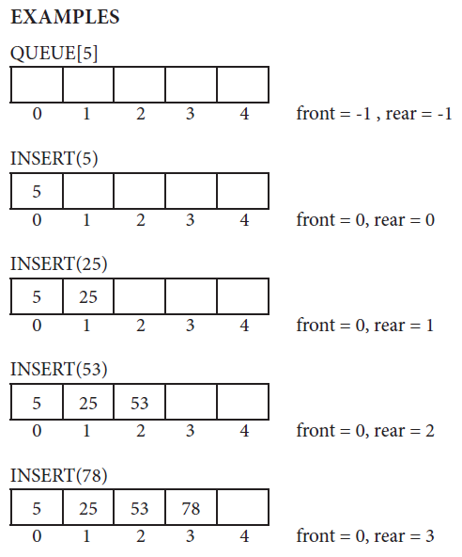
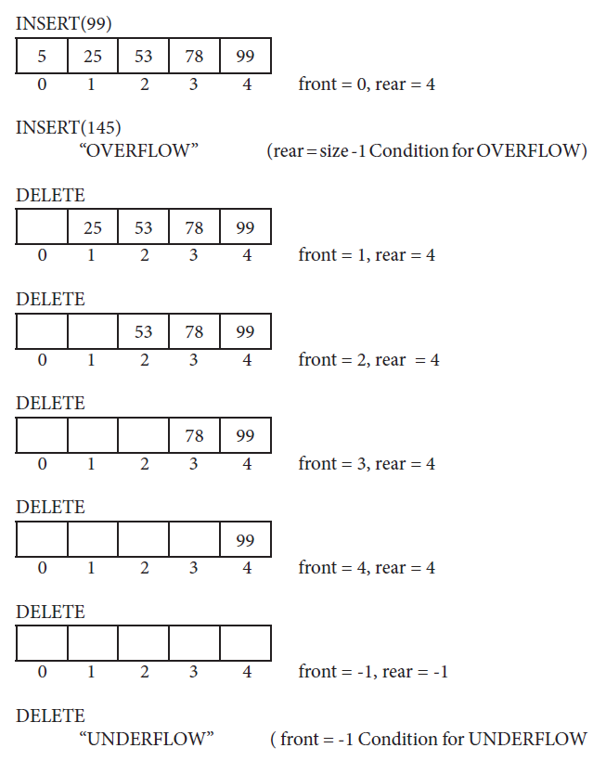
Linear Queue

Slide 28
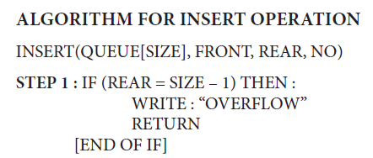
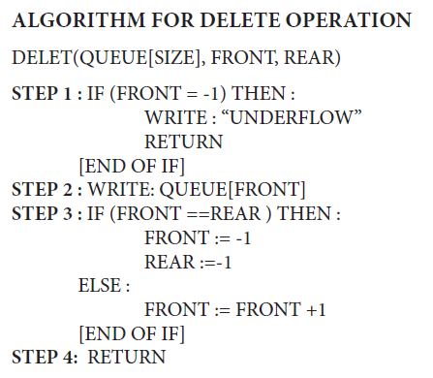
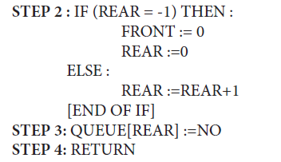
Linear Queue

Slide 29
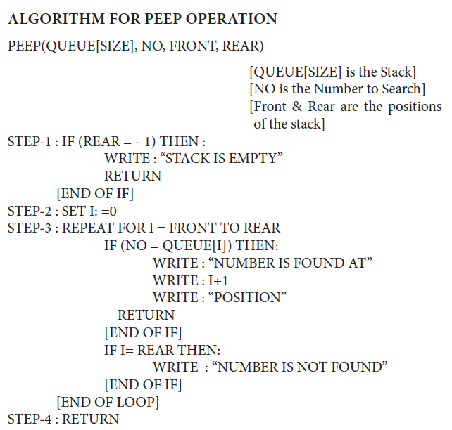
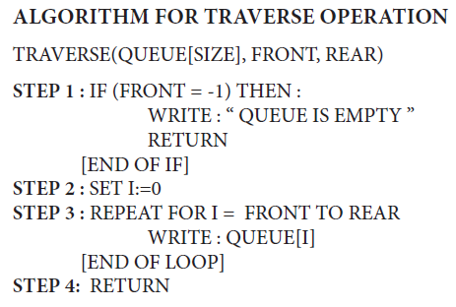
Linear Queue

Slide 30
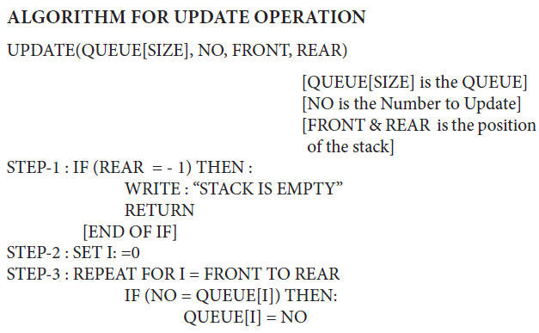
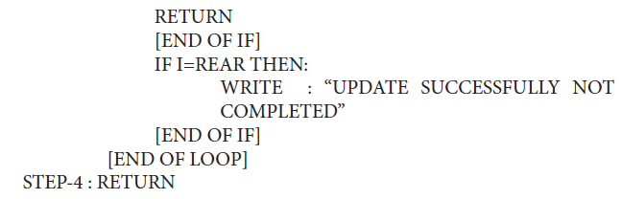
Linear Queue

Slide 31
Problem of Linear Queue
A queue
After A leaves,
After B and C leave
How can we insert a new element?!!
D
C
B
A
Max
rear
front
D
C
B
Max
rear
front
K
G
I
H
G
F
E
D
Max
rear
front

Slide 32
Solution
One solution is to shifting all items to front when dequeue operation.
After A leaves,
After B and C leave
Too Costly…
D
C
B
A
Max
rear
front
D
C
B
Max
rear
front
Max
G
F
E
D
rear
front

Slide 33
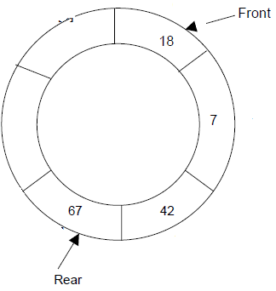
A better Solution
A better solution is a circular Queue

Slide 34
Circular Queue
In circular queue the rear and front end of the queue are inter connected, i.e/ after reaching to the rear end if the front end is not at zero then rear will again set to zero , and same also implemented with the front end also.
OVERFLOW Condition for OVERFLOW
rear = size -1 and front = 0 OR FRONT = REAR +1(for the QUEUE starts with 0)
Rear = size and front = 1 OR FRONT = REAR +1(for the QUEUE starts with 1)
UNDERFLOW Condition for UNDERFLOW
Front = -1 (for the QUEUE starts with 0)
front = 0 (for the QUEUE starts with 1)
CONDITION FOR EMPTY QUEUE
Front = -1 and Rear = -1 [for the QUEUE starts with 0]
Front = 0 and Rear = 0 [for the QUEUE starts with 1]

Slide 35
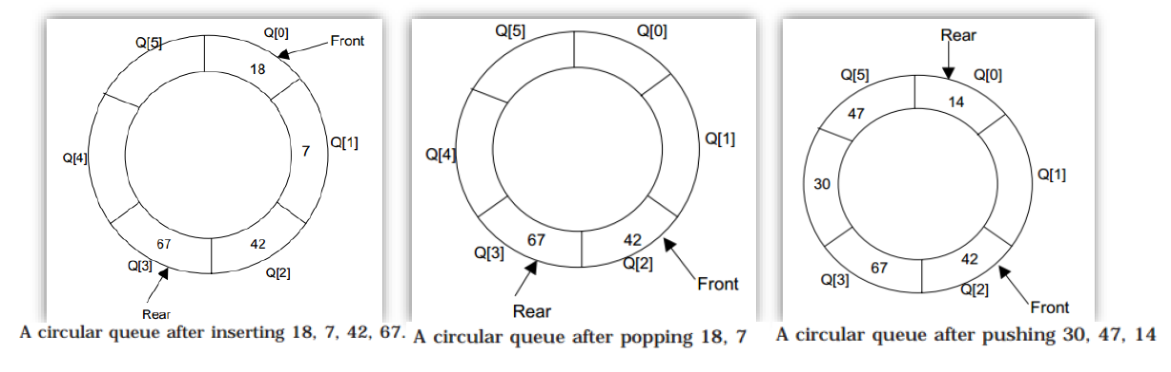
Circular Queue

Slide 36
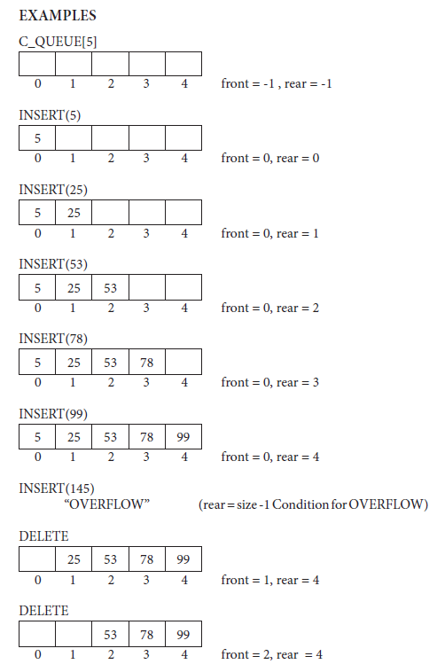
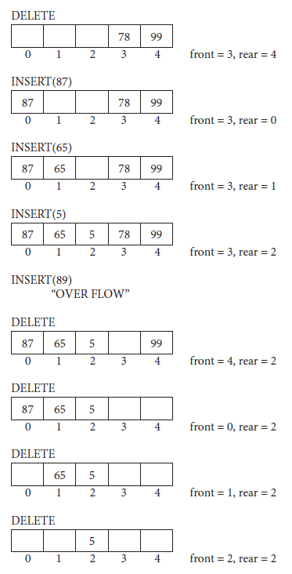
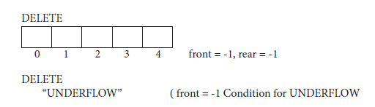

Slide 37
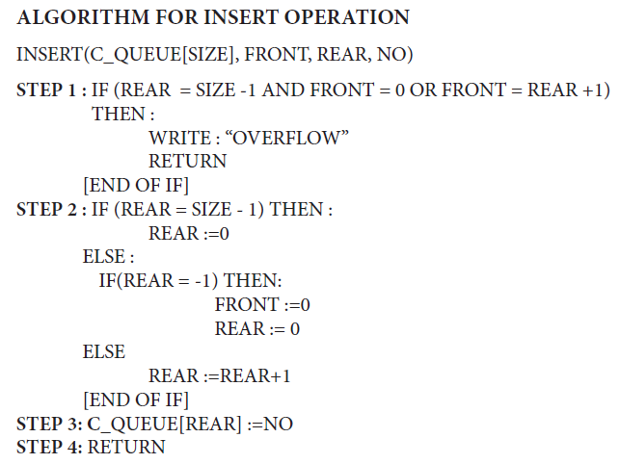
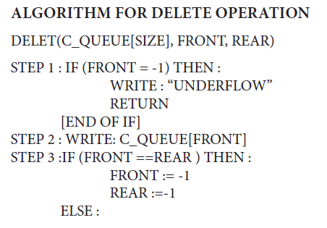
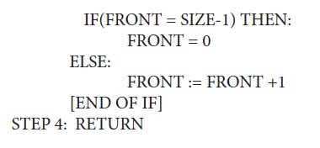
Circular Queue

Slide 38
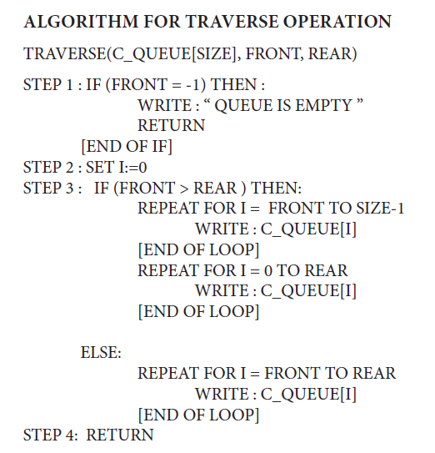
Circular Queue

Slide 39
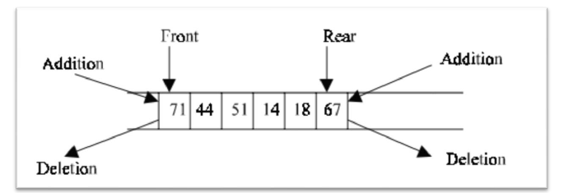
Double Ended Queue
The Double ended queue is also called as D-QUEUE or DE-QUEUE or DEQUE which allows to perform the insertion and deletion operation at both the ends.
Depending upon the operations this can be categorized into two types as
Input Restricted DEQUE
Output Restricted DEQUE
INPUT RESTRICTED DEQUE
Insertion is allowed only at one end (rear end),
Deletion is allowed at both ends (rear and front ends)
OUTPUT RESTRICTED DEQUE
Deletion is allowed only at one end (front end),
Insertion is allowed at both ends (rear and front ends)

Slide 40
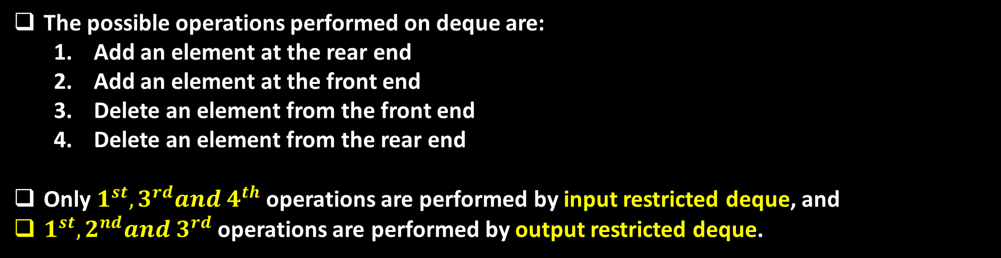
Operations on Deque
The possible operations performed on deque are:
Add an element at the rear end
Add an element at the front end
Delete an element from the front end
Delete an element from the rear end
Only $1^{st},3^{rd}and 4^{th}$ operations are performed by input restricted deque, and
$1^{st},2^{nd}and 3^{rd}$ operations are performed by output restricted deque.

Slide 41
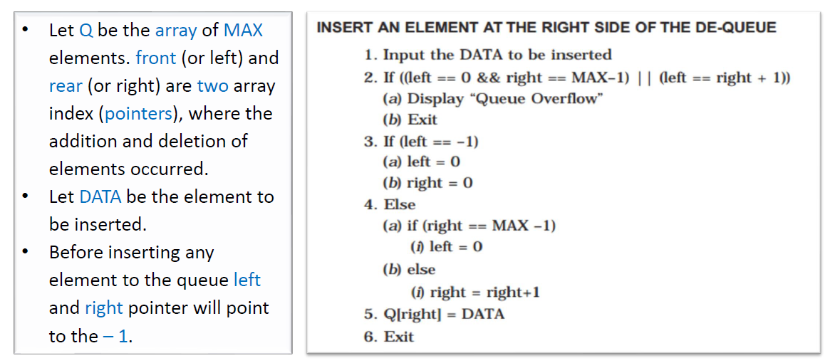
Deque Algorithms
right = 0

Slide 42
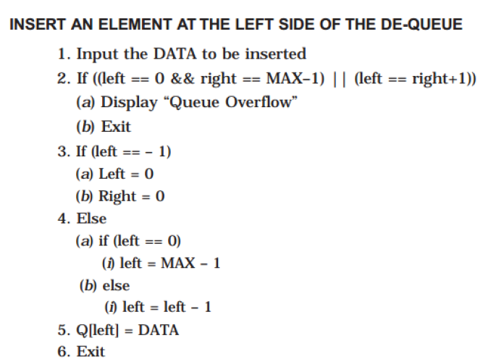
Deque Algorithms

Slide 43
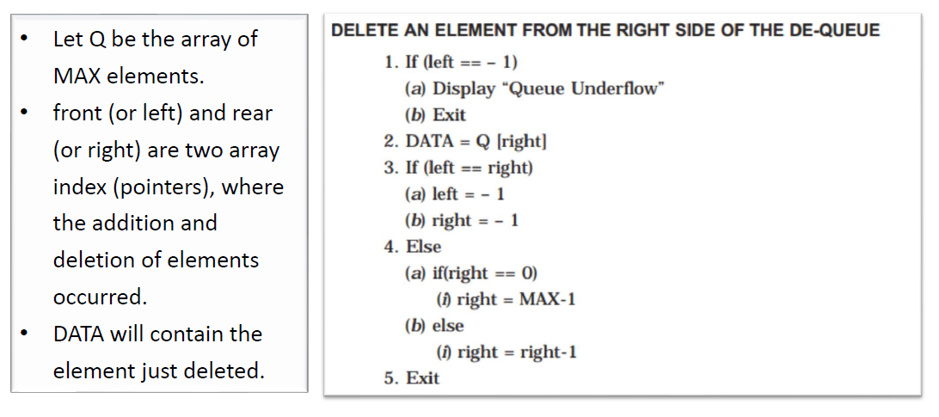
Deque Algorithms

Slide 44
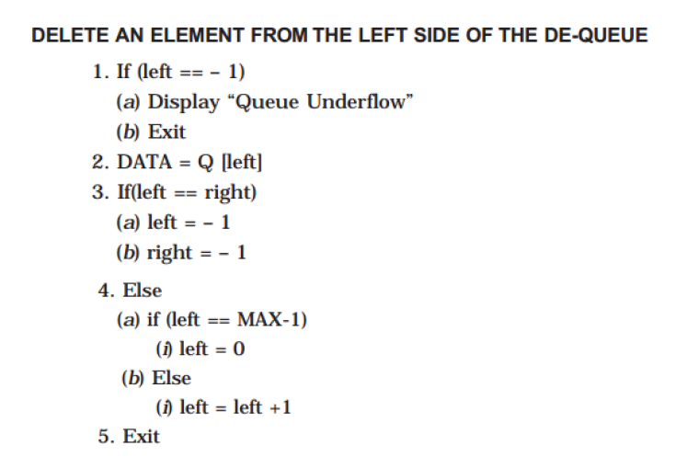
Deque Algorithms

Slide 45
Priority Queue
Priority Queue is a queue where each element is assigned a priority .
In priority queue, the elements are deleted and processed by following rules
An element of higher priority is processed before any element of lower priority.
Two elements with the same priority are processed according to the order in which they were inserted to the queue.
For example, Consider a manager who is in a process of checking and approving files in a first come first serve basis.
In between, if any urgent file (with a high priority) comes, he will process the urgent file next and continue with the other low urgent files.

Slide 46
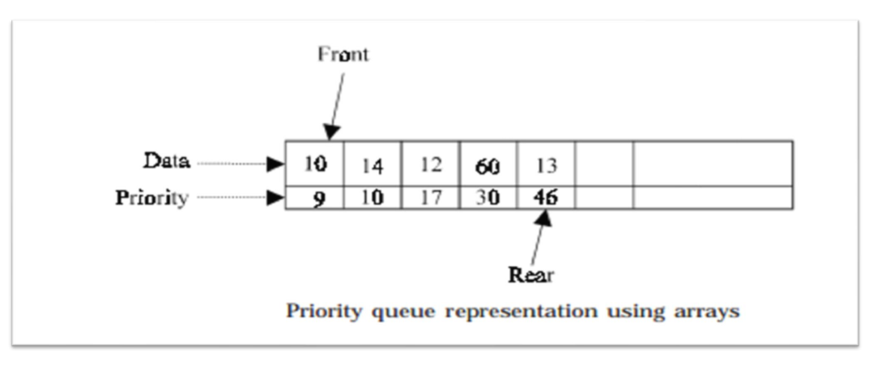
Priority Queue

Slide 47
Priority Queue
Above Fig. gives a pictorial representation of priority queue using arrays after adding 5 elements (10,14,12,60,13) with their corresponding priorities (9,10,17,30,46).
Here the priorities of the data are in ascending order .
Always we may not be pushing the data in an ascending order.
From the mixed priority list, it is difficult to find the highest priority element if the priority queue is implemented using arrays .

Slide 48
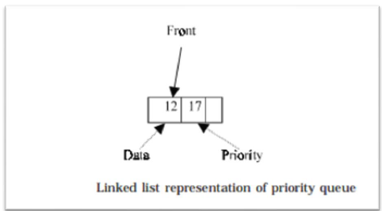
Priority Queue
Using linked list, a node in the priority queue will contain
DATA stores the actual information
PRIORITY stores the priority of DATA
NEXT field stores the address of the next node.
When an element is inserted into the priority queue, it will check the priority of the element with the element(s) present in the linked list to find the suitable position to insert.
The node will be inserted in such a way that the data in the priority field(s) is in ascending order .
We do not use rear pointer when it is implemented using linked list , because the new nodes are not always inserted at the rear end.

Slide 49
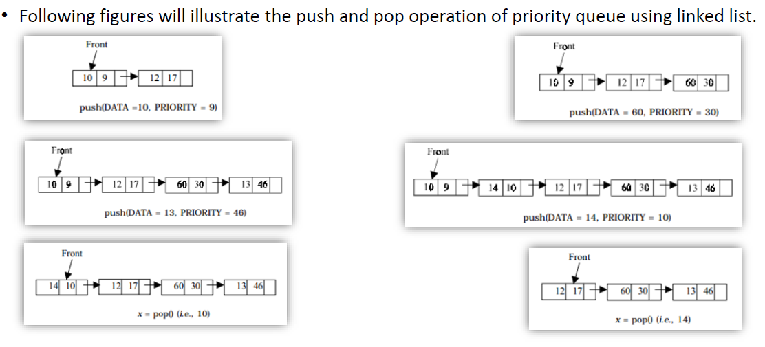
Priority Queue

Slide 50
Queue STL and deque STL
queue<T>
Operations:
Empty
pop (= dequeue)
Push (= enqueue)
Size
Front
back
deque<T>
Stands for: double ended queue
Operations:
empty
pop_back (remove last element)
pop_front (remove first element) (=dequeue)
push_back (= enqueue)
push_front (adds an element at the start)
size
front
back

Slide 51


